Slide 1

MindCanvas
Vivekanand Education Society Institute of Technology
Mentor: Mrs. Indu Dokare
Members: Ketaki Buwa (D12A)
Chinmay Joshi (D12A)
Rahul Gurnani (D12C)
Faizanshah Ansari (D12C)

Slide 2
Index
Problem Statement
Literature Survey
Block Diagram
Methodology
Functional requirements
Non Functional Requirements
Hardware requirements
Constraints
Flowchart
References
`

Slide 3
Problem Definition
India is a vast country with a population of 1.2 billion people where at least five crore people live with a mental illness and most of them are even unaware of it, reason being currently there are less than 4000 psychiatrists in India and visiting a psychiatrist is believed to be a stigma. On the other hand, a search on a Global scale for “Human Resource Management” on LinkedIn shows around 4 million results in an employed population of 4 billion people, Even if we assume that the quantity is enough, “Quantity” can never assure us of “Quality”. In both the cases, the most important part of the Human Resource - “The Brain” could be misjudged. Thus, for having an unbiased judgment that is equally reachable to all we proposed a System which looks like a Game but does your “Psych-Analysis” behind the scenes using the powers given by Image processing and Machine Learning on behavioral analysis.

Slide 4
Literature Survey
Ma Xiaoxi, Lin Weisi ,Huang Dongyan, Dong Minghui, Haizhou Li . IEEE 2nd International Conference on Signal and Image Processing. .Facial Emotion Recognition. 2017:This paper mainly focuses on different learning methods, and has implemented several methods. Support Vector Machine (SVM) and Deep Boltzmann Machine (DBM) for facial emotion recognition.
Anand Rao and Neelima Pradhan.Perceived work deadlines.2014: Work deadlines acts as one of the sources of stress that may lead to cause some dysfunctional consequences to the individual as well as to the organizations. The present study was undertaken to examine the influence of personality on perceived work deadlines among software professionals

Slide 5
State-Trait Anxiety Inventory: An emotional state exists at a given moment in time and at a particular level of intensity. Anxiety states are characterized by subjective feelings of tension, apprehension, nervousness, and worry, and by activation or arousal of the autonomic nervous system.
Charles R. Harrell, Bruce Gladwin, Michael P. Hoag. Mitigating the “Hawthorne Effect” in simulation studies: This paper examines the potential impact of the Hawthorne effect on simulation studies and presents several case studies where it has occurred and been successfully managed. Techniques for detecting and dealing with this psychological phenomenon are presented.

Slide 6
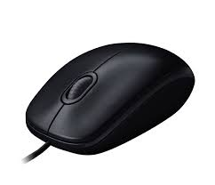
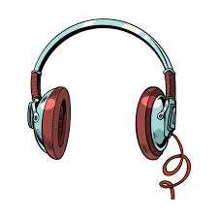

MOUSE TRACKING
BLOCK DIAGRAM
EXPRESSION
CLASSIFIER
VOICE INSTRUCTION
ENGROSSING
BACKGROUND MUSIC
EXPRESSION RECOGNITION
MODEL
ANAGRAM GAME MODULE
DATA COLLECTION AND
ANALYSIS
LINKING
ANAGRAMS
SUB-TASK
ASSIGNMENT
MODULE
ACCURACY AND CONSISTENCY
ANALYSIS
MODEL
RESULT DISPLAY (GUI)

Slide 7
Methodology
Step 1: Meeting psychiatrists & Human resource managers for planning stage.
Psychiatry is a very vast field. Every different case of psychiatry needs to be studied thoroughly to come to an exact conclusion. With psychiatric consultation, we will determine exact measures/tests required for knowing the state of mind of a person. A detailed study of this with a physiatrist will help us to determine the measures to be considered for designing the game.
Step 2: Designing the game to implement the taken model.
The game will be making use of human brain analytics by using special sounds & color schemes. All the instructions will be given through the headphones and various situations will be created for the player to handle. Efforts would be made to precisely judge the concentration level of the person as well as his/her mental strength.

Slide 8
Step 3: Building up a proper Human Expression Dataset.
This will involve the collection of image data and biforgation according to its classification using metadata provided with the dataset. It will be crucial at this step to remove the garbage data from the dataset before sending it to further processing.
Step 4: Implementing Image Processing and applying Machine Learning on the facial images.
We will be using OpenCV library for image processing and google’s TensorFlow model to train our dataset. Since training a model from scratch is a time consuming process we will be using google’s Pre-trained model called “Inception v3 to train the final layer of the Convolutional Neural Network (CNN) according to our need.

Slide 9
Step 5: Collection and Analysis of subject based upon Mouse Movement Pattern.
Subjects mouse cursor movement and click actions would be captured to measure the extent of logical approach for connecting the anagrams. This will easily separate out subjects using random approaches.
A training Methodology and Model will be searched for the implementation of the same.
Step 6: Calculating the cumulative result of the Models.
The data from the expression model as well as mouse pattern model will be clubbed to make a overall realization of the subjects capabilities and mental state.
Step 7: Measuring the accuracy, reliability, and scalability of the product.
As soon as the project reaches “Beta” level we will conduct outsourced testing on the product to know the deviation of the project from our expectations.

Slide 10
Functional Requirements
A game module based on ANAGRAMS.
Using this game module to initiate and abstract the whole analysis process.
Assuring that subject feels he is playing a game is not being analysed for his/her mental efficiency in any manner.
Two “Trained Machine Models” to analyse patterns in expressions and mouse movements.
Capability of model to self-analyze its mistakes and learning from them.

Slide 11
Providing the subject with appropriate tasks (sub-goals inside the game module) to exercise the full capacity of its brain.
Generation of a well-formed report (chart) to showcase the result of subject’s analyses.

Slide 12
Non-Functional Requirements
Proper lighting and noise free environment.
The subject should preferably be in isolation while playing the game.
Availability of a large number of test subjects for training and testing the application.
Machine model should be able to adapt to people of different personalities.
Machine model should have fidelity even when subjects expression is ambiguous.

Slide 13
Constraints
Machine Model has accuracy which is limited to people without spectacles.
Limited availability of databases corresponding to Indian Faces.
The image dataset should be sufficient to detect the minute changes in expressions.
A periodic update will be required to keep a check on the performance.
Knowledge of english

Slide 14
Hardware and Software Requirements
A good quality headphone for judicious analysis based on subjects attentiveness.
A webcam to capture subject’s expressions and a module to monitor webcam’s functioning.
A mouse set at a fixed Dots Per Inch (DPI) and a module to capture mouse actions.
A computer with Gpu for training models.
Google’s TensorFlow Environment and Deep Learning Tools.
Image processing library - OpenCV
GUI and Game Development - Pygame and Tkinter

Slide 15
Flowchart

Slide 16
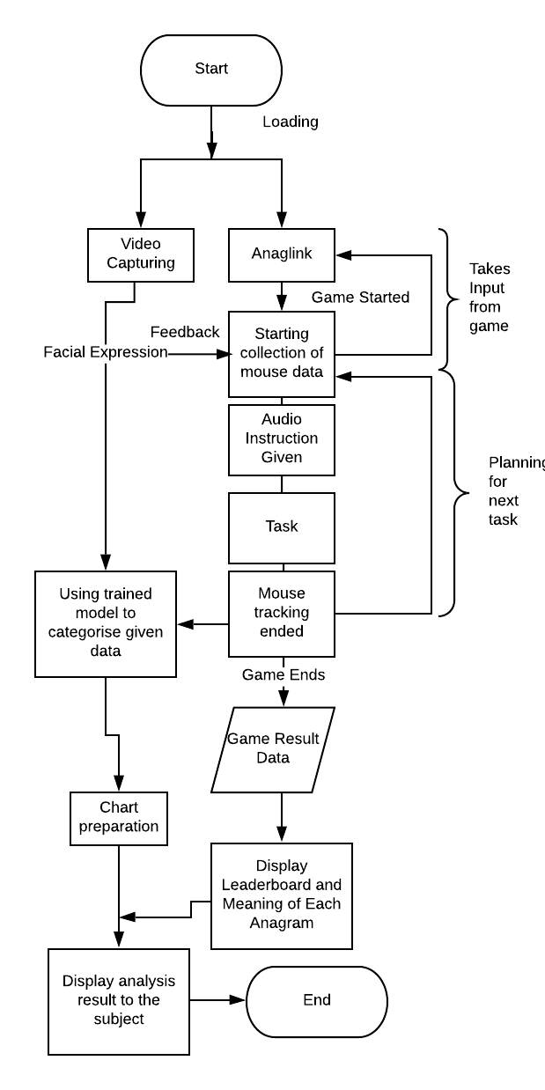

Slide 17
References
Ma Xiaoxi, Lin Weisi ,Huang Dongyan, Dong Minghui, Haizhou Li . IEEE 2nd International Conference on Signal and Image Processing. .Facial Emotion Recognition. 2017
Soumik Mondal and Patrick Bours.Continuous Authentication using Mouse Dynamic T.V. 2017
Anand Rao and Neelima Pradhan.Perceived work deadlines.2014
Fang Yuan Wan†, Yi Wen†, Yan Yang§, Zhiping.State-Trait Anxiety Inventory.Available:
Charles R. Harrell, Bruce Gladwin, Michael P. Hoag. Mitigating the “Hawthorne Effect” in simulation studies.1994

Slide 18
Nishitha Aysha Ashraf, “There are less than 4000 psychiatrists in India: Is medical education to blame?,” April 3, 2018. [Online]. Available: https://www.thenewsminute.com/article/there-are-less-4000-psychiatrists-india-medical-education-blame-78952. [Accessed Feb. 14 2019].
P. Lucey, J.F. Cohn, T. Kanade, J. Saragih, Z. Ambadar and I. Matthews, "The Extended Cohn-Kanade Dataset (CK+): A complete dataset for action unit and emotion-specified expression", in the Proceedings of IEEE workshop on CVPR for Human Communicative Behavior Analysis, San Francisco, USA, 2010.Available: http://www.consortium.ri.cmu.edu/index.php
Michael J. Lyons, Shigeru Akemastu, Miyuki Kamachi, Jiro Gyoba. Coding Facial Expressions with Gabor Wavelets, 3rd IEEE International Conference on Automatic Face and Gesture Recognition, pp. 200-205 (1998). .Available: http://www.kasrl.org
Brian Lee Yung Rowe .Oct 18, 2016 .New York,
Available: https://codeload.github.com/muxspace/facial_expressions.

Slide 19
Bainbridge, W.A., Isola, P., & Oliva, A. (2013). The intrinsic memorability of face images. Journal of Experimental Psychology: General. Journal of Experimental Psychology: General, 142(4), 1323-1334. Available: http://www.wilmabrainbridge

Slide 20
Conclusion
The gestures and expressions thus act as a major measure for detecting the mental makeup of a person and analysing his capability for a particular job. Also the application serves as a platform for self assessment and psychoanalysis in a interactive form.

Slide 21
THANK YOU

